Slide 1
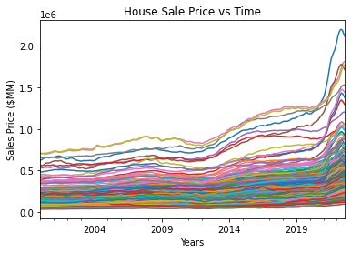
How we Decided on our Model
Plotting 22 years of price changes, an increase of house sale price through time is apparent with a few events reflected in the trend e.g., 2008 market crash and 2020 COVID pandemic.
Implemented the most basic machine learning algorithm “Linear Regression”, since 2 independent variables were left after the data clean process (date and zip code).
Due to the wide range in Sales Price trends by zip codes, a linear regression model was implemented for each zip code to predict Housing Sales Price.
Notes:
How we decided on our model

Slide 2
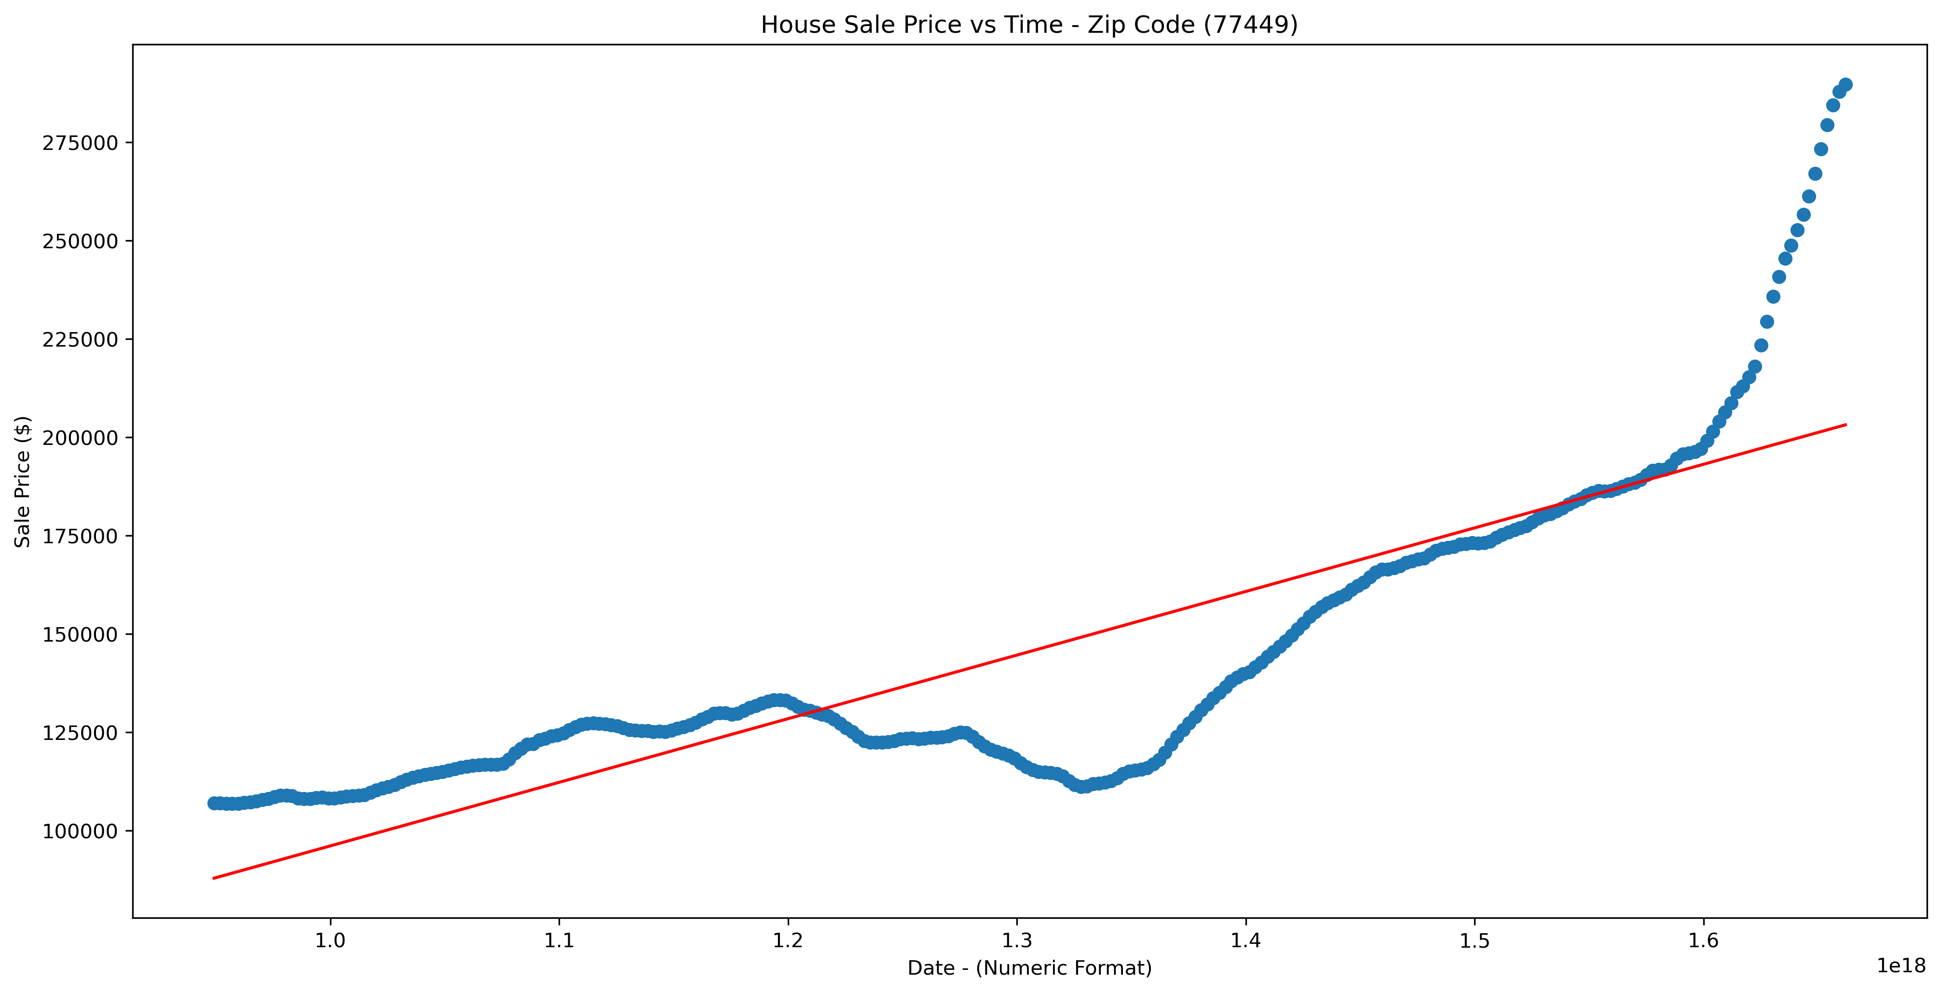

Process of Building Model and Saving Data
Dates (X) passed through “to_datetime()” function to convert it to float numeric for regression purposes.
Sales Price (y) reshaped into array.
Created linear regression model with scikit-learn and fit data into model.
Model R2 score for 77449 zip code is 0.7109
For loop built to go over each zip code in data frame and stored slope and intercept into a dictionary.
Saved slope and intercept by zip code in .csv file to be used in the HTML prediction calculations
Notes:
Linear regression workflow.
NO splitting of data in train and testing due to the fact that special events will have an impact on the linear regression model predictions.

